Slide 1
Multi-class Object Detection From Intersection Surveillance Camera Using RDFCN
Team 6, Team 7
Iowa State University

Slide 2
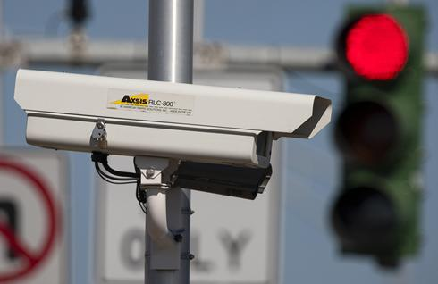
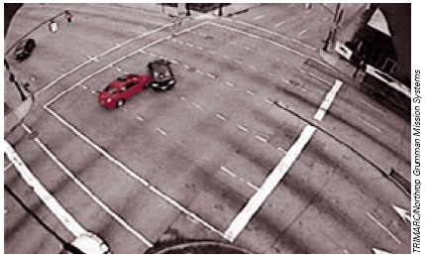
Introduction – Challenge Track 1
Transportation can benefit from data captured by surveillance cameras
Challenge Task: Detect and classify object from intersection cameras
14 classes: [Car, SUV, SmallTruck, MediumTruck, LargeTruck, Pedestrian, Bus, Van,GroupOfPeople, Bicycle, Motorcycle, TrafficSignal-Green, TrafficSignal-Yellow, TrafficSignal-Red]

Slide 3
Approach - RDFCN
RDFCN - Region-based Deformable Fully Convolutional Networks (MSRA 2017.06)
R-FCN (Region-based Fully Convolutional Networks)
Key idea: shared convolution
Benefit: faster inference speed
Deformable ConvNets (Deformable Convolutional Networks)
Key idea: adaptive convolutional filters
Benefit: higher detection accuracy

Slide 4
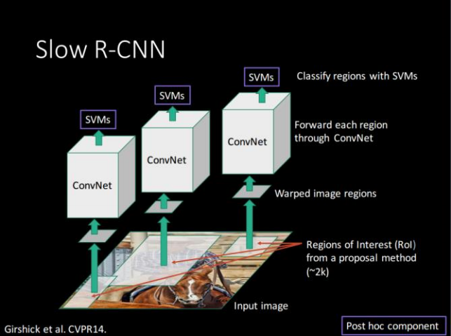
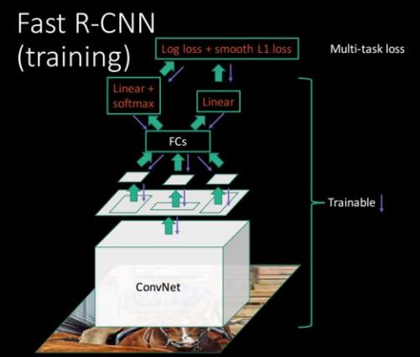
Approach – Shared Convolution
By Shaoqing Ren, Kaiming He, Ross Girshick, Jian Sun
By Shaoqing Ren, Kaiming He, Ross Girshick, Jian Sun

Slide 5
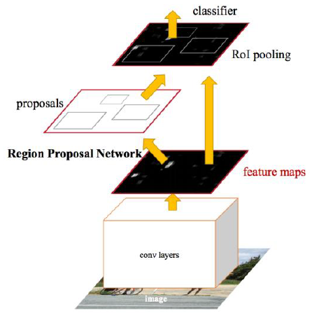
Approach – Shared Convolution
Faster R-CNN
By Shaoqing Ren, Kaiming He, Ross Girshick, Jian Sun
By Shaoqing Ren, Kaiming He, Ross Girshick, Jian Sun

Slide 6
Approach – Shared Convolution
Faster R-CNN
RFCN
R-FCN
Final Result
Location Sensitive Maps
By Shaoqing Ren, Kaiming He, Ross Girshick, Jian Sun

Slide 7
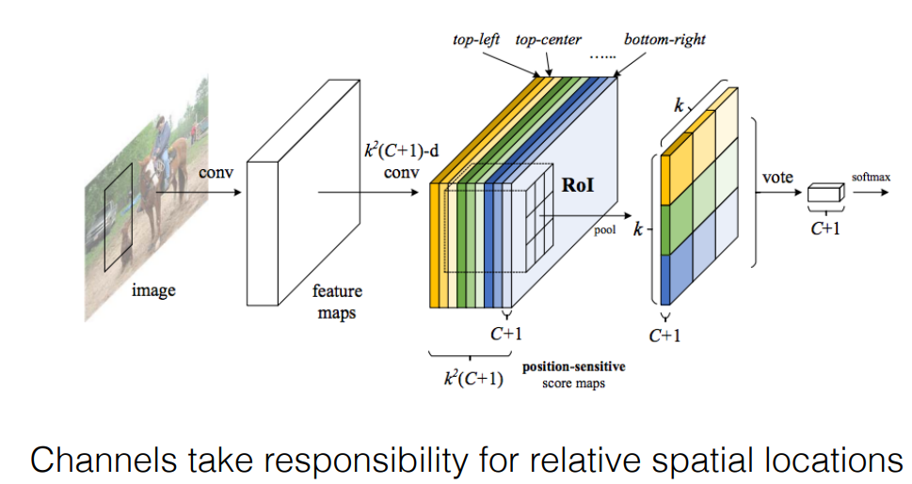
Approach – Location Sensitive Maps
By Jifeng Dai, Li Yi, Kaiming He, Jian Sun

Slide 8
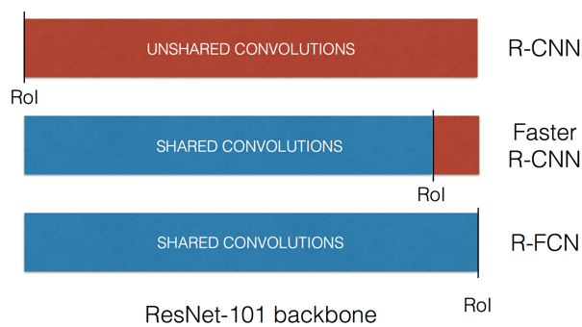
Approach – RFCN
More Shared Convolution = Faster Inference Speed
By Jifeng Dai, Li Yi, Kaiming He, Jian Sun

Slide 9
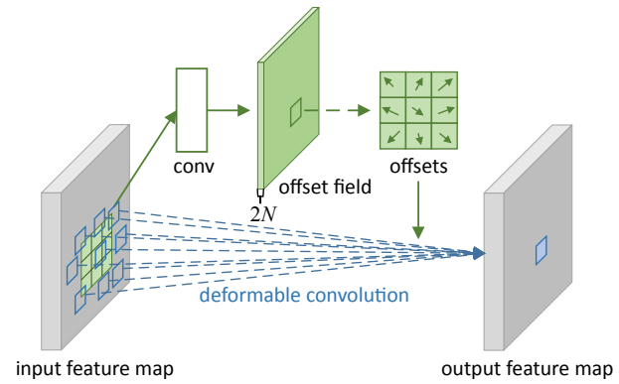
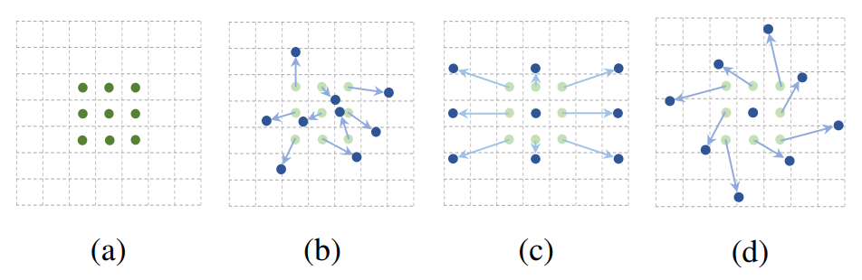
Approach – Deformable ConvNets
Add an additional convolutional layer to learn the adaptive-shaped filter
By Jifeng Dai, Haozhi Qi, Yuwen Xiong, Yi Li, Guodong Zhuang, Han Hu, Yichen Wei

Slide 10
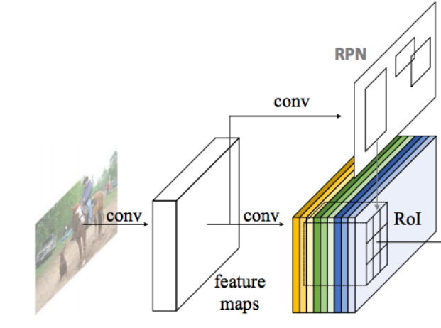
Approach – RDFCN
Resnet-101
Deformable
Output layer

Slide 11
Approach – Transfer Learning with RDFCN
Train from scratch
Pre-train mode on UADETRAC, Fine-tune both RPN and RFCN
Pre-train model on UADETRAC, Fine-tune only RFCN
Pre-train model on COCO, Fine-tune both RPN and RFCN
Pre-train model on COCO, Fine-tune only RFCN
Resnet-101
(pre-trained)
Deformable
Output layer

Slide 12
Results – Tested on selected 200 images
Trained on ~59,000 images in train.txt of aic1080 (detect 11 classes except traffic signals)
Tested on 200 images pre-reserved from train.txt of aic1080

Slide 13
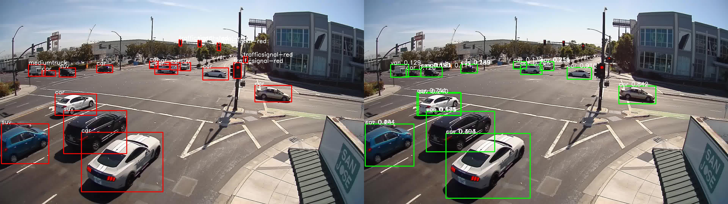
Demo – Annotation vs Detection 1/10
Detect far away objects

Slide 14
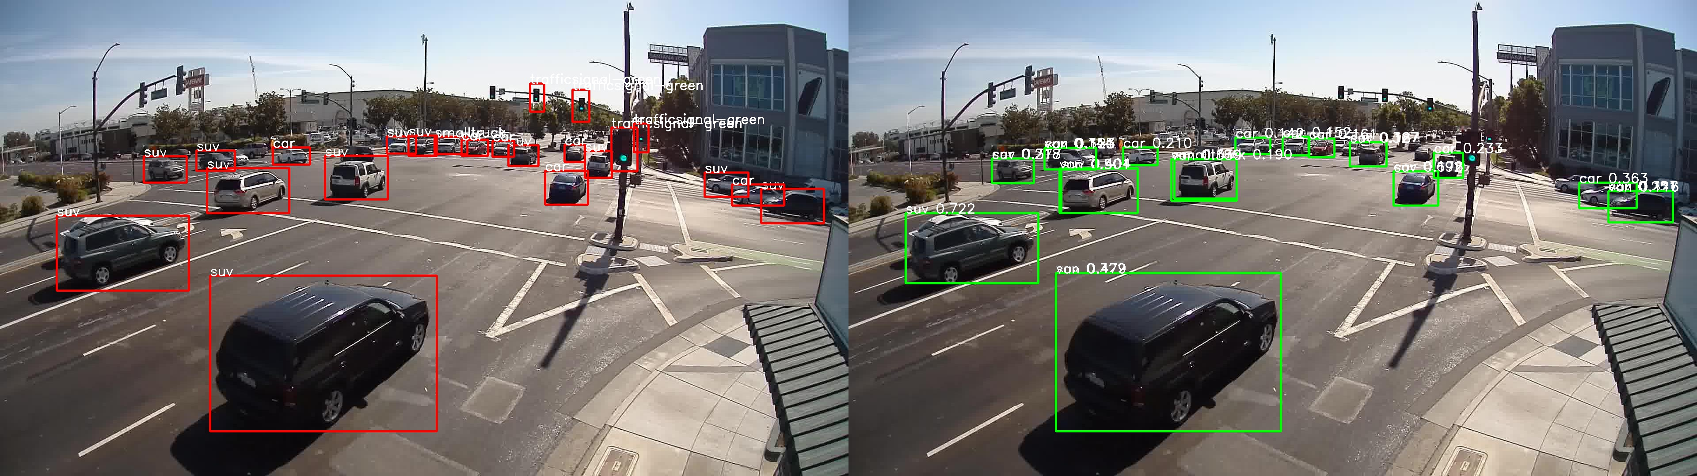
Demo – Annotation vs Detection 2/10
Detect far away objects

Slide 15
Demo – Annotation vs Detection 3/10
Detect far away pedestrian

Slide 16
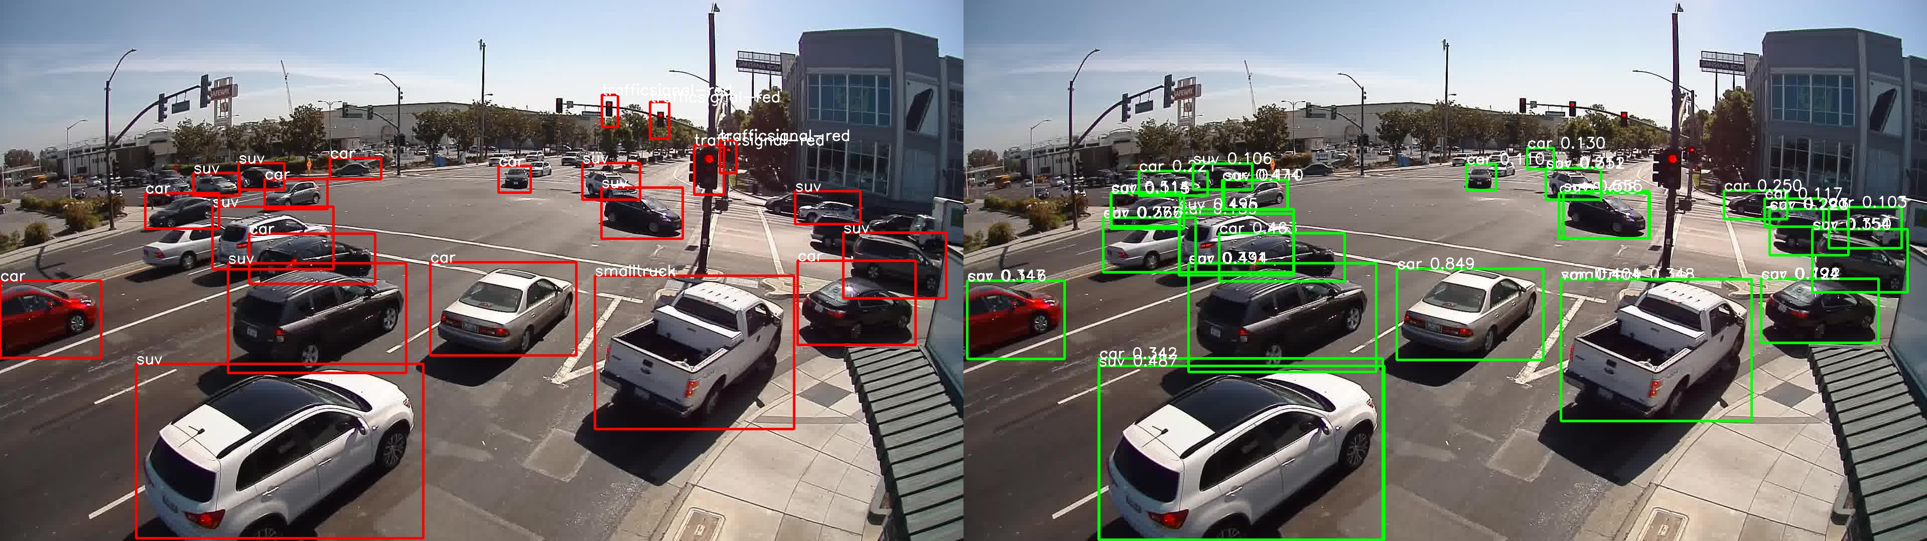
Demo – Annotation vs Detection 4/10
Detect missing cars in the annotations

Slide 17
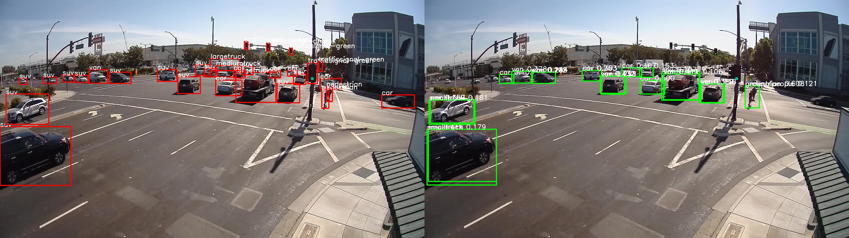
Demo – Annotation vs Detection 5/10
Detect group of people

Slide 18
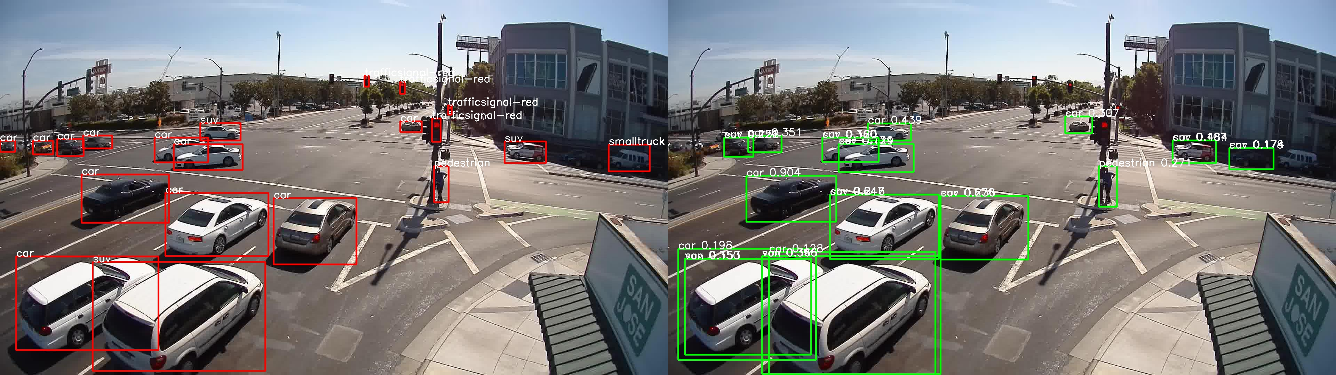
Demo – Annotation vs Detection 6/10
Confused Car and SUV

Slide 19
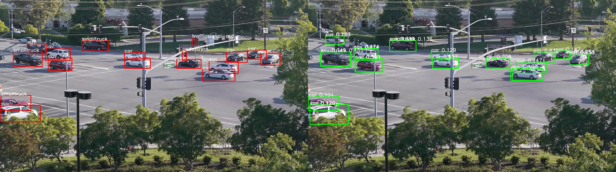
Demo – Annotation vs Detection 7/10
Detect far away objects

Slide 20
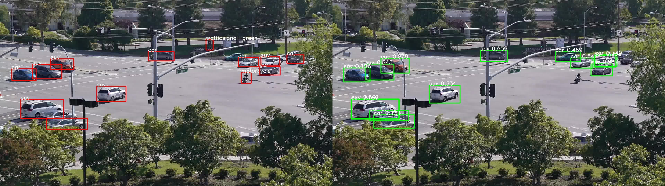
Demo – Annotation vs Detection 8/10
Detect occluded cars

Slide 21
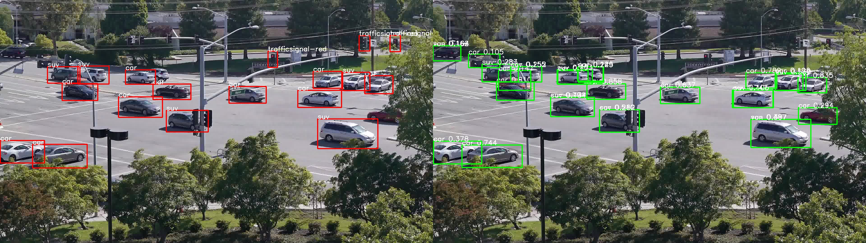
Demo – Annotation vs Detection 9/10
Detect missing cars in the annotations

Slide 22
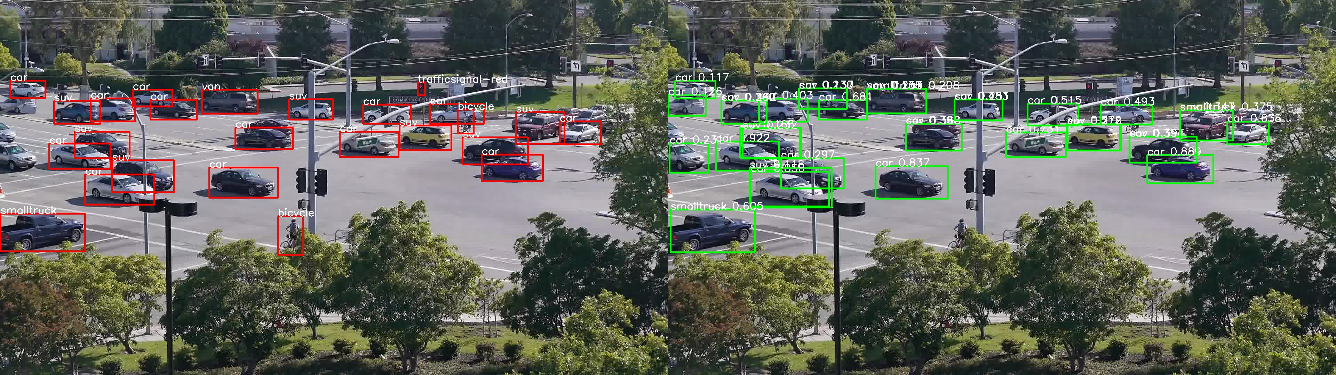
Demo – Annotation vs Detection 10/10
Detect missing cars in the annotations

Slide 23
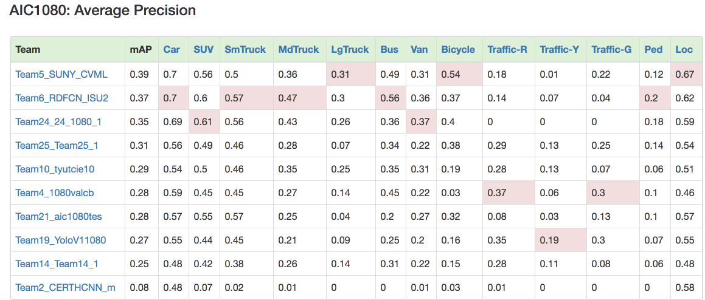
Final Submission – mAP =37%

Slide 24
THANK YOU

